Slide 1
BS3 Community Impact: A Holistic Approach to Wellbeing

Slide 2
The Mission
“We reinvest surplus generated from our profitable services into educational, arts, environmental, health and wellbeing projects that we either run directly or support partners to deliver.”

Slide 3
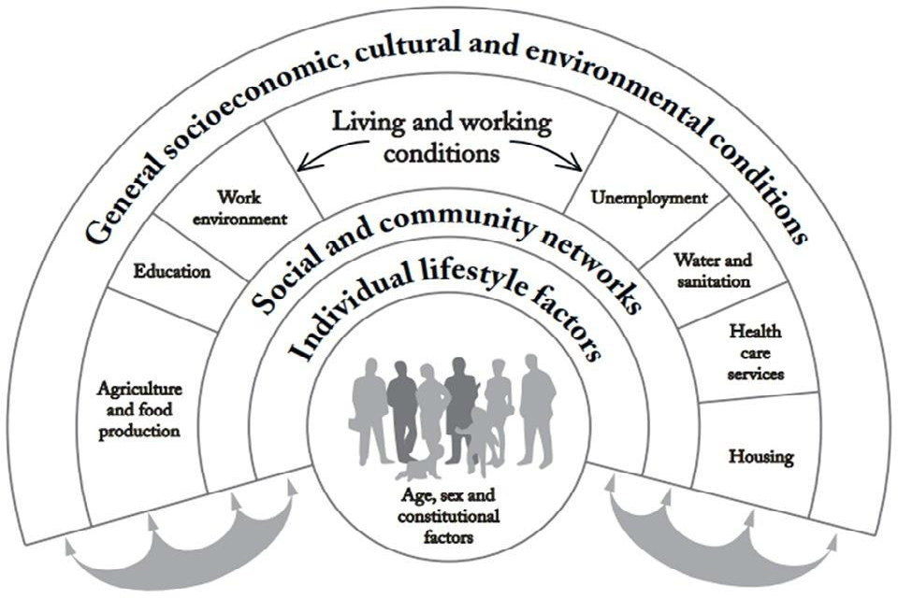
Wellbeing
Social
Environmental
Community
Emotional
Intellectual
Physical

Slide 4
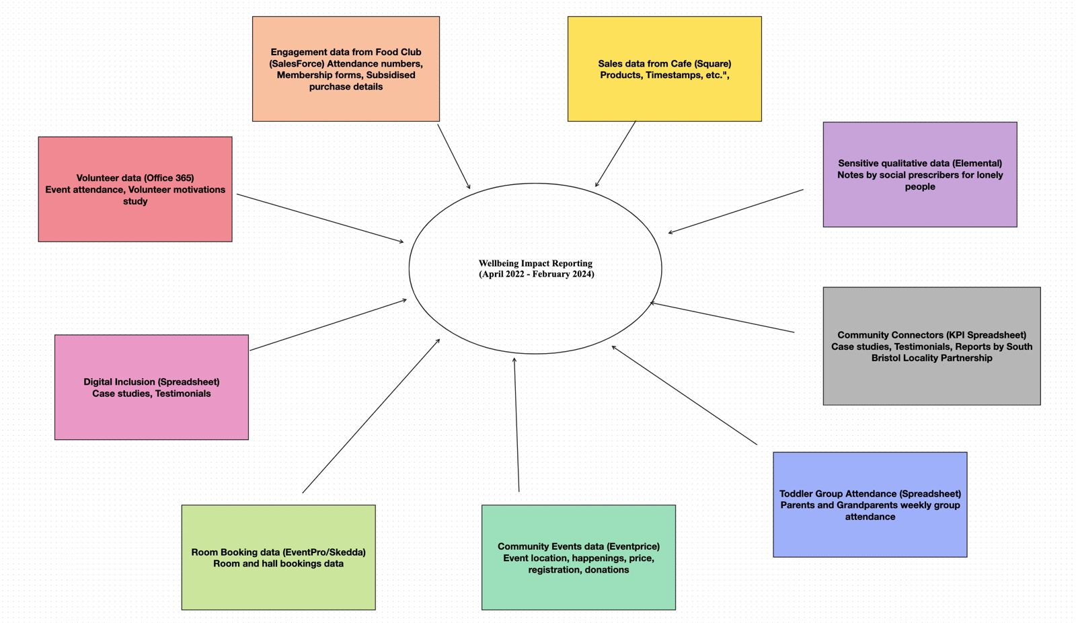

Slide 5
Square Sales Data
Number of transactions per day and trends over time.
A heatmap of geography showing the spread of the community's influence.
Visuals showcasing amenities and the impact on mental health.
https://www.changeworks.org.uk/wp-content/uploads/2023/09/Changeworks-Impact-Report-2022-23-final.pdf

Slide 6
Social Prescribers Qualitative Data
Hours spent engaging with people and the number served.
Age distribution graph to highlight inclusivity.
Social prescribers' engagement and thematic analysis of behavior changes.
https://blogs.ufv.ca/chasi/2022/07/26/impact-of-covid-19-on-post-secondary-students-a-systematic-review-of-institutional-reports/

Slide 7
Toddler Group Attendance
Graphs showing attendance trends and the impact on community involvement.
Possible correlation with café sales data for revenue insights.

Slide 8
Community Events Data
Show different infographics for different kinds of events with statistics and dates
Attach this to the concept of community wellbeing
Show by adding the number of people regularly attending and personalized stories for impact and attendees asking for those kind of events again.
https://groups.friendsoftheearth.uk/join
https://impactreview.lrfoundation.org.uk/en/
Clickable map links leading to event information and infographic

Slide 9
Community Connectors Data
Included in community events
Additional thematic analysis and testimonials
Infographic showing roadmap of journey of 2-3 people
Number of people joining these groups
https://www.health.org.uk/infographic-what-makes-us-healthy

Slide 10
Room Booking Data
Revenue data and usage statistics showing increased awareness and foster trust in event management.
Images and descriptions of available spaces and past events.
Direct link to availability and booking page.
https://avonneedstrees.org.uk/about-us/

Slide 11
Digital Inclusion Data
Testimonials and case studies highlighting the impact of both educational programs till now.
Infographics showing thematic analysis (progress in digital literacy).
Statistics like “95% boost in perceived confidence” etc.
https://literacypirates.org/impact-report/
https://createarts.org.uk/our-impact/who-we-work-with/

Slide 12
Food Club Data
Data on the variety and volume of food provided. (Nutritional Impact)
Graphs showing the growth in attendance. (M-o-M or Y-o-Y avg)
Revenue vs. Cost
Waste management strategies infographic with images.
https://static1.squarespace.com/static/5f54eb0c3e5b8919789377d7/t/65731bfd116c542baf3238f2/1702042626470/Impact+Report+2022+-+Final+0712.pdf
List of partners helping to be added.

Slide 13
Conclusion: The Circle of Wellbeing
Mission and Charter Commitment
Wellbeing Spectrum Cover
Integrate All Aspects

Slide 14
Next Steps
Types of Analyses Possibilities:
1
List potential analyses techniques and metrics relevant to BS3 Community data.
Data Verification:
2
Ensure existing data quality and completeness for accurate analytics.
Confirmation with BS3 Community:
3
Align with BS3 Community to validate the proposed analysis plan.
Analytics and KPI Development:
4
Initiate the process of data analytics and key performance indicator (KPI) tracking.
Sample Report Creation:
5
Craft a sample report to demonstrate the insights and value of the analyses.
Presentation of Ideas:
Arrange a meeting to present initial ideas and sample findings to BS3 Community.

Slide 15

Questions?

Slide 16
kcx cef
dcj nd

